Slide 1
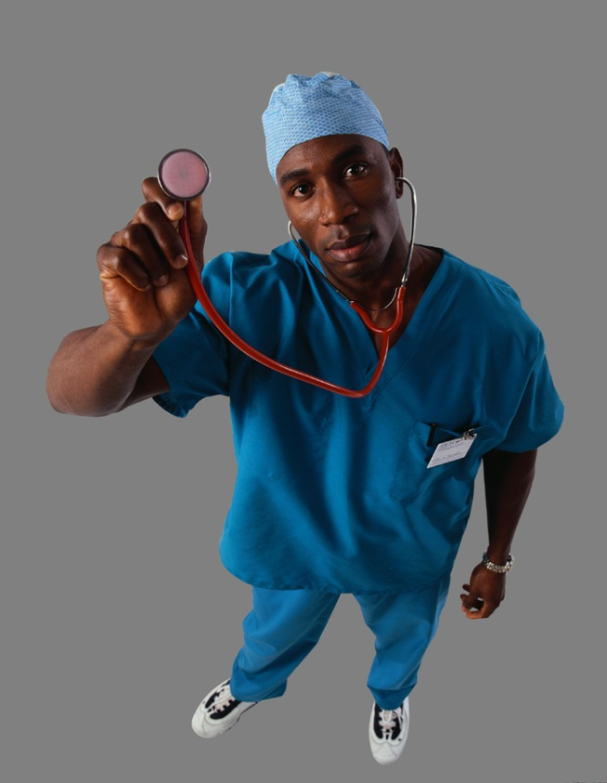
WHAT IS HEALTH?

Slide 2
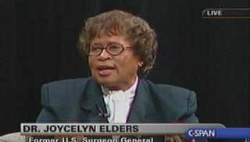
ABOUT THIS COURSE
You can’t teach a child who isn’t healthy and you can’t keep a child healthy who isn’t educated.

Slide 3

How would you define health?
(Before you click the next slide, make sure you have written your own personal definition of health.)

Slide 4
Basic dictionary definition
Health is the absence of
illness.

Slide 5

Health is a
state of complete
Physical, Mental & Social Wellbeing.
1947

Slide 6
The condition of being sound in body, mind, or spirit.
Merriam-Webster Dictionary
Perfect
Health

Slide 7
Health is an integrated method of functioning which is oriented toward maximizing the potential of which the individual is capable.
Halbert Dunn, 1967

Slide 8
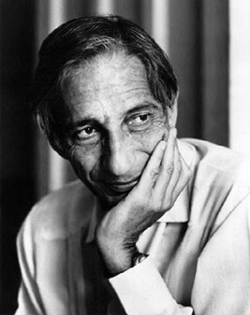
Health is not freedom from the inevitability of death, disease, unhappiness and stress…
but rather the ability
to cope with them in
a competent manner.
Ivan Illich, 1967

Slide 9
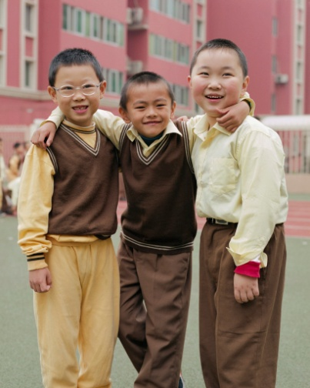
Health is getting enough exercise and good food, having good relationships with your friends and family and making your brain
work everyday.
HEE 330 Student

Slide 10
How will you as a teacher, influence the health and well-being of your students?

Slide 11
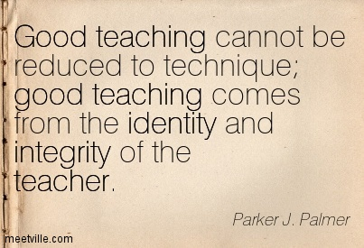
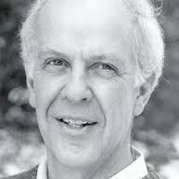
As I teach I project the condition of my soul onto my students, my subject, and our way of being together.
Dr. Parker Palmer
Founder of the
Courage to Teach Program

Slide 12
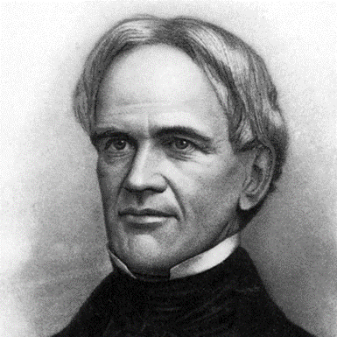
Survey conducted in 2000 by the Horace Mann Educators Corporation
Nearly half of Americans surveyed said one teacher had the most impact on their success as an adult.
Horace Mann 1796-1859

Slide 13
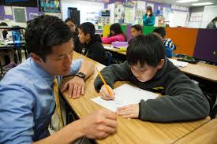

Nearly all believed that the teacher’s interpersonal skills were more influential than the subjects they taught.
What does that mean? Interpersonal skills.

Slide 14
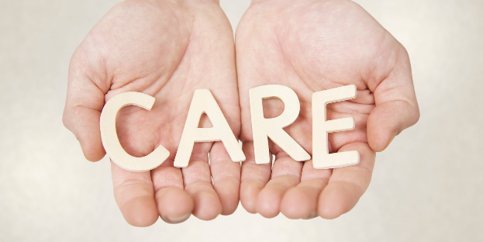
Taking a personal interest in the student
Listening
Making learning interesting
Holding students to a high standard

Slide 15
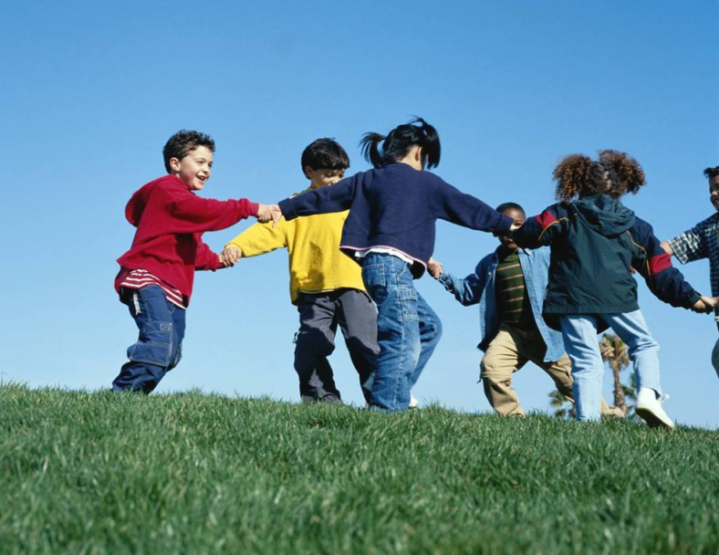
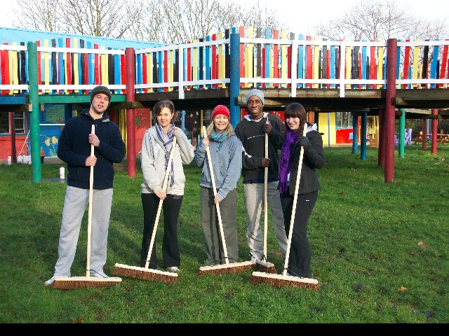
We need to teach our children how to be healthy, but that has less to do with what they eat and how fast they run than it does with how they feel about life; whether or not they have hope for the future;
whether or not they are good citizens of their communities; and whether or not they see the value in giving as well as
receiving.

Slide 16
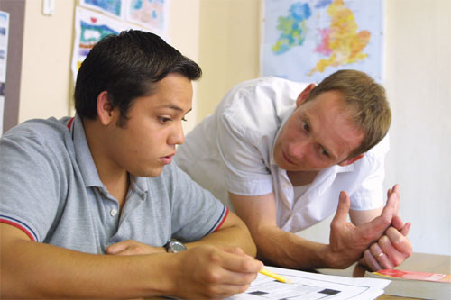
The great thing about teaching kids to be healthy is that you, as teachers, can do it as you go about the day to day work of teaching
English,
History,
Math
or Science.

Slide 17
